Slide 1
BLiP: A Peer-to-Peer Chat System
Jeremy Boissevain
Nile Livingston
Nehemiah Paramore

Slide 2
Peer-to-Peer Systems
Advantages:
No single point of failure
Can be highly scalable
More suitable for anonymity
Disadvantages:
No simple client/server model
Must trust users to maintain state; no central backup
Slow peers can cause latency issues, bottlenecks

Slide 3
Design Goals
Privacy
Security
Scalability
Not interested in anonymity

Slide 4
Supported Chat Functionalities
End-to-end textual communication
Persistent list of friends
Multiple concurrent active chats

Slide 5
Problem I: Address Resolution
Distributed hash table (e.g. Chord)
Stores (username, IP) pairs
Peer adds own username-address mapping on joining the network
To get an address for a username, just ask the DHT
Chord vs Kademlia

Slide 6
Problem II: User Authentication
Challenge: no central certificate authority (CA)
Solution: Have peers authenticate each other

Slide 7
“First Pass” Strategy: Polling
A trying to authenticate identity of B
Poll some number of peers and authenticate only if a majority authenticates
Disadvantages:
Increased complexity
More network traffic
Requires critical mass of users on network; if too small, no majority exists

Slide 8
A Simpler Strategy: End-to-End Persistent Trust
On username creation, generate (public user key, private user key)
User is trusted to maintain and protect these keys
On accepting a connection for the first time:
Simply trust user’s identity, exchange public user keys
On every subsequent connection to B:
Compose a verifier string, V, and send it to B
B hashes V (e.g. SHA-1), “signs” result with private key, and sends it back
Verify B’s response with B’s public key. If match, then authenticate.
Problem: duplicate usernames

Slide 9
Problem III: Privacy
RSA
Public/private k-bit keys
Higher k ➔ more secure
Session keys
After authentication, trade session keys, use for entire conversation

Slide 10
BLiP Session Outline
1. A queries DHT to find address for receiver B.
2. A sets up a direct, persistent TCP connection to B.
3. Trade username, public user keys and perform authentication
4. On successful authentication, generate and trade public session keys
5. For duration of chat, encrypt messages and send them to receiver
6. To leave, simply send a teardown message and close the socket

Slide 11
Demonstration!

Slide 12
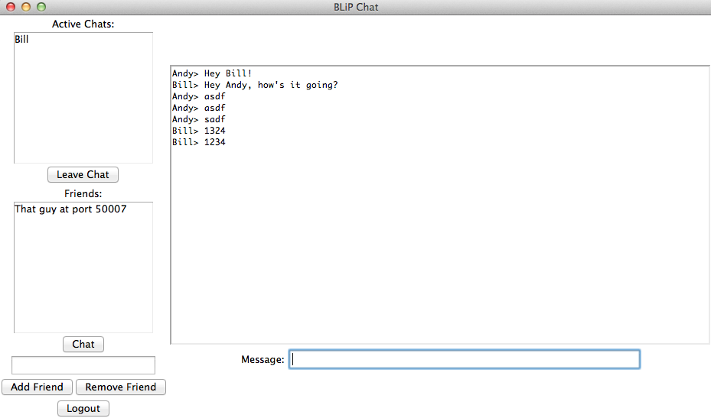

Slide 13
Implementation Details
Python chosen for quick prototyping and library availability
GUI implemented using Tkinter
Peer.py stores most of the relevant state and implements important functions
ServerThread.py runs in the background and accepts incoming TCP connections
ChatThread.py: one created for every active chat session

Slide 14
Evaluation Ideas
Scalability concerns
How many active connections can a peer handle at once?
Malicious nodes (DDoS), abusing DHT lookups
How does the performance of peers (measured in benchmark RT) vary with network size?
Likely dependent on DHT properties

Slide 15
Questions?

